Slide 1
STAFFING dISCUSSION
Bruce Rollins - Gulf Chair
Bob Wilson – New Mexico Chair
John King – Pacific Chair
Teddy Decker – New Mexico

Slide 2
Purpose Today:
Is to get you to think about how you currently staff your LMSC
Is to get you prepared for tomorrow
Maybe a tomorrow you do not expect today!
Help set up the rest of this summit
Attracting, Developing and Inspiring Volunteers
Implementing USMS Strategic Plan
Budgets and LMSC Standards

Slide 3
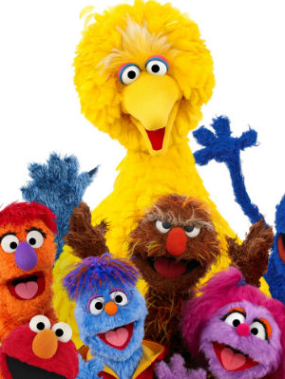
How are we all alike in structure?
One of These Things is Not Like the Others…3 have something in common. Which one does not belong?
A) Chair
B) Treasurer
C) Registrar
D) Secretary
Answer: Registrar – Not required to be an elected position by USMS Standards.

Slide 4
How are we all alike in structure?
How many leadership positions are required in each LMSC?
Bonus Question: How many are Mandatory and how many are Target standards?
Answer: There are 7 Mandatory – Chair, Vice Chair, Registrar, Secretary, Top 10 Recorder, Treasurer, Sanctions Chair.
There are 2 Target – Officials & Coaches

Slide 5
My Premise:
Each LMSC is
Unique,
Important and
Full of Potential !
None of our LMSCs are exactly alike in membership, assets and structure, nor should we all strive to be alike!

Slide 6
How Diverse are we?
How many LMSCs – 52
Largest LMSC – Pacific +12M members
Smallest – Border 47 members
Membership average – 1,262 (1,050 – Pacific)
Average Assets - $39K ($33K – Pacific)
5 Time Zones
10.6 Leadership positions per LMSC -3 to 19

Slide 7
STAFFING Stories
1. Traditional Method
2. Show Stopper Transitions
3. Futuristic Tailoring

Slide 8
Traditional
How did we meet?
What do you do?
How about a job?
Want to go to Convention?
What National Committee do you want to be on?
What are you doing for the rest of your life?

Slide 9
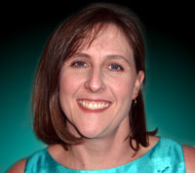
Traditional
Source: Teddy Decker NM Chair
To tell that story is Bob Wilson
1. Asked to participate
2. Identified Talent(s)
3. Invited to Convention
4. Asked to be Chair, too
Easy story to identify with?
A lot of us had to learn on the fly!

Slide 10
STAFFING Stories
2. Show Stopper Transitions

Slide 11
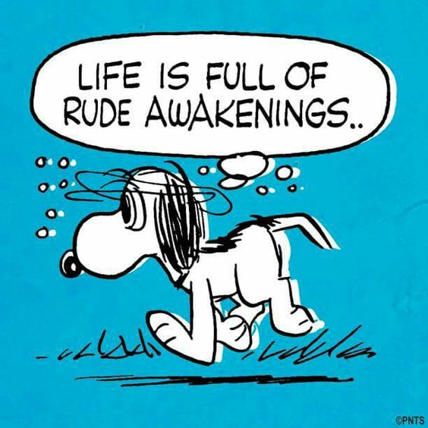
Life is full of Rude Awakenings
Just when you think you have it made…
You might not!

Slide 12
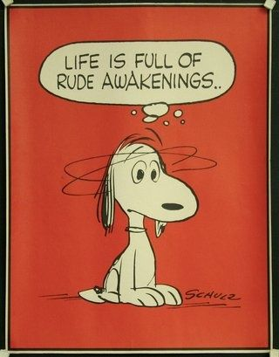
Last Summit –
Gulf LMSC – 1500 members
Staffed by veterans – Over 140 years of experience
Veteran leaders from National Positions
Then…we hit a rough spot!
New Chair
Registrar
Web Master
Treasurer
Top 10 Recorder
Where do I go for help?

Slide 13
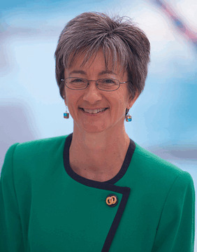
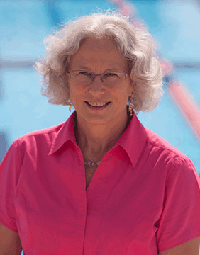
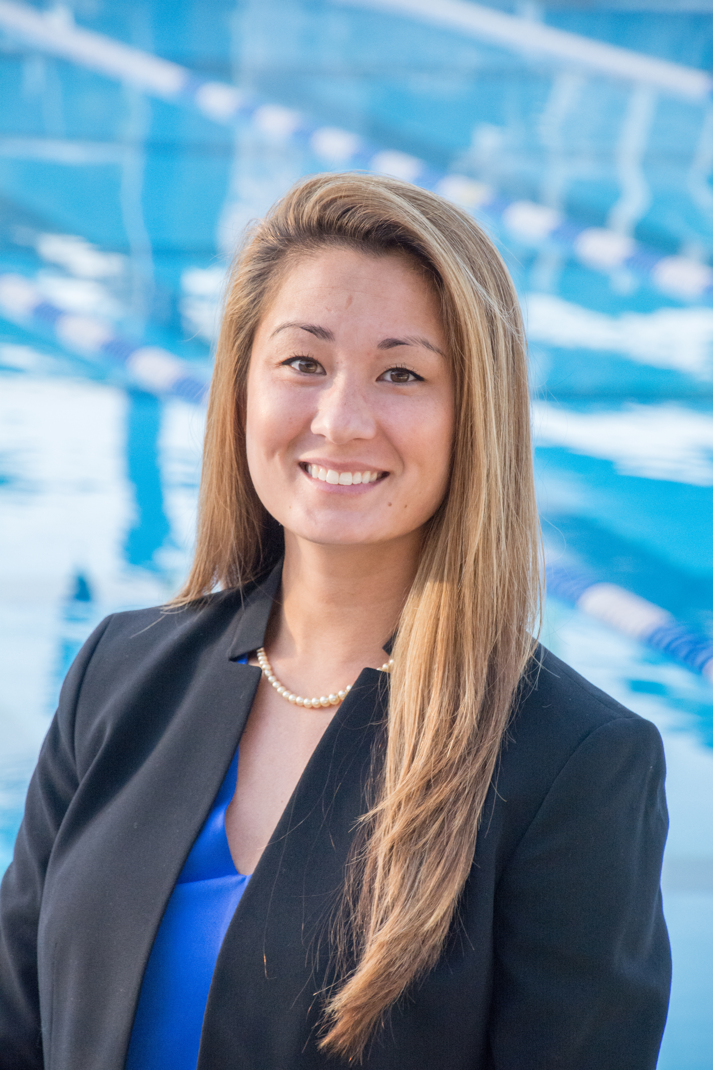
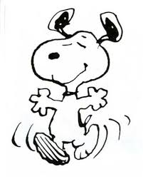
Your Life-lines at the National Office
Anna Lea Matysek Tracy Grilli
Director Membership Director Member Services
Jessica Porter
Senior Director Services
Go to them first!
Do not wait for them to come to you!

Slide 14
STAFFING Stories
3. Futuristic Tailoring

Slide 15
What does your current organization look like?
Chair, Treasurer, Secretary, Registrar
Vice Chair, At Large Chair, Sanctions
Top 10 Recorder, Coaches, Fitness,
Communications, Webmaster, Officials
Open Water, Safety, etc….
Most Chairs are
a Committee of One!

Slide 16
What might your future organization look like?
John King – Pacific LMSC
Goal: To reorganize their LMSC to reflect their operation
1. To streamline reporting lines to Chair
2. To focus operations on 4 major functions
a. Pool Events
b. Open Water Events
c. Coaches and Clubs
d. Communications
3. Each function was a committee
with a VP over each function
4. Still maintained separate
Treasurer, Secretary &
Registrar positions as direct reports

Slide 17
STAFFING
Points:
Does your current organization have some structural drawbacks?
Yes…You can think outside the box!
Are you training future leaders?

Slide 18
STAFFING
What might you have learned
or thought about today?
As a Leader:
Are you prepared for tomorrow?
Are there any organizational tweaks to make it better?
Do you know where help resides?

Slide 19
STAFFING
Questions:
Thank you
Lunch Time!

